Slide 1
Disclaimer
This PowerPoint contains Confidential information.
Do not circulate this or tell patients they might have COVID 19 from this test.
Just use it to optimise your and your patient’s immune system.

Slide 2
Discovering how to test for COVID 19

Slide 3
First make sure the patient is fully neurologically organised.
(Most Epigenetic’s practitioners are familiar with this technique. If so jump to slide 8 but remember you must make sure that the patient is neurologically organised before the COVID19 testing.)

Slide 4
Using the composite acetates test Yang / Yin with eyes closed.
Then test each separate meridian to identify Causal meridian.
Effect meridian is the one that negates this meridian.

Slide 6
Maintain causal meridian acetate and tap SCN point 60x at 2Hz. This will lock the patient into the causal meridian.
The Effect meridian will negate the Causal meridian and now will weaken in the clear.

Slide 7
There will be weak associated muscles on both meridians found.
If all associated muscles not weak shine UV light* (obtainable from Epigenetics Ltd) into Glabella for 20 seconds. Most important.
All associated meridian muscles now test weak and the patient is now fully neurologically organised.

Slide 8
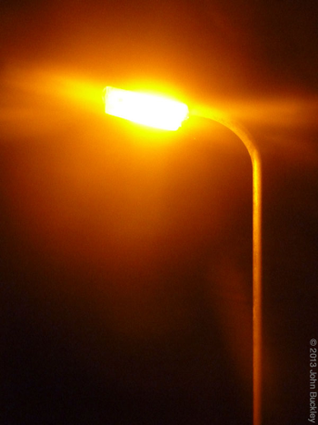
Spectroscopic emission
Every living and non-living compound whether organic or not emits a spectroscopic emission when heated.
We see this when the
orange street lights are
turned on at dusk.

Slide 9
These lights contain sodium gas which has a spectroscopic emission like this –
Sodium Spectroscopic emission
But the human eye sees this

Slide 10
However when all these different colours are layered together we humans see the bright orange glow when the light is on, which can be measured as a single monochromic emission.
The human eye perceives light from the violet end of the spectrum at 385nm to the red end of the spectrum at 645-770nm.

Slide 11
My finding is that COVID 19 spectroscopic emission is at 633nm in the orange spectrum.
633nm
You can print this off either on paper or best on an acetate sheet. If on paper place it coloured side down on the patient or patient looks at it.. This acetate is now available from Epigenetics Ltd www.epigenetics-international.com

Slide 12
Thus if a patient weakens in the clear to this specific coloured acetate you can say that they might currently have COVID19.
But of course never base a diagnosis on this finding alone.
You must follow government guidelines in such a case.

Slide 13
I have tested this remotely using hair samples of known cases of COVID 19 and they weaken in the clear if the virus is (still) active.

Slide 14
Most people do not weaken in the clear to this acetate as they are currently not infectious.
However most people who do not weaken in the clear weaken when the acetate is challenged whilst therapy localising the current WON time point.

Slide 15
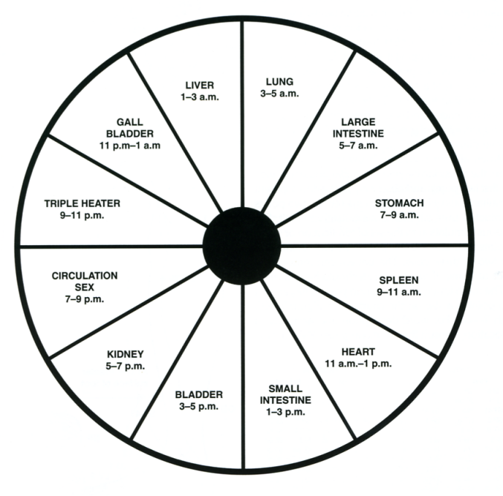
The WON time point is the coupled meridian’s ALARM point to the NOW time.
NOW time WON time
Lung 4-6am LI
LI 6-8am Lung
St 8-10am Sp
Sp 10-12midday St
Ht 12-2pm SI
SI 2-4pm Ht
Bl 4-6pm Kid
Kid 6-8pm Bl
Cx 8-10pm TW
TW 10-12midnight Cx
GB 12-2am Liv
Liv 2-4am GB
BST Summer times

Slide 16
If the Alarm point is bilateral Therapy Localise both sides.
This does not mean they have COVID19 but if they were exposed to it you can find what will optimise their immune system against it.

Slide 17
From this weakness you can now discover exactly what the individual requirements are to improve immunity against the virus. e.g.
Liposomal Vitamin D3
Zinc SA
Vitamin C (Sodium ascorbate tends to test best and Potassium ascorbate during infection)
Probiotics, Coconut oil
All products and test vials available from www.epigenetics-international.com

Slide 18
I wonder if the complimentary colour would be therapeutic if used as light therapy also ??
Complement to 633nm
This acetate is now available from Epigenetics Ltd www.epigenetics-international.com
Use a strong torch light through the acetate to the Thymus / Spleen area.

Slide 19
Chapman’s Reflexes
Dr Goodheart integrated these reflexes into Applied Kinesiology using the Organ / Muscle / Meridian connection. They stimulate the organs lymphatic drainage and this is of special importance at this time in relationship to optimising the immune system.

Slide 20
The Immune System
Thymus Infraspinatus TW
Spleen Latissimus dorsi Sp
Middle Trapezius Sp
Lower Trapezius Sp
Triceps Sp
Thoughts on the COVID19 Outbreak by Walter Schmitt D.C. and Kerry McCord D.C. Facebook 18th March 2020

Slide 21
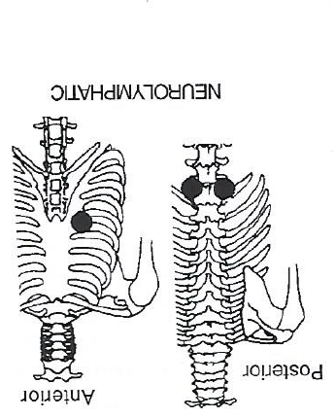
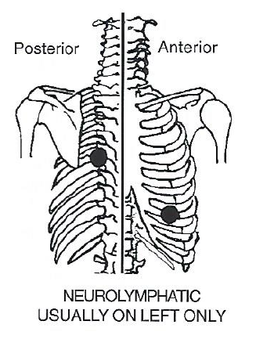
Chapman’s Reflexes Points
Thymus Spleen
5th IC space
7th IC space laterally
USUALLY ON RIGHT ONLY

Slide 22
Remember that blood flows through all our organs every few minutes.
Rubbing the Neurolyphatic reflexes decongests the organ enabling it to carry out it function.
Thoughts on the COVID19 Outbreak by Walter Schmitt D.C. and Kerry McCord D.C. Facebook 18th March 2020

Slide 23
The Thymus is a specialised
primary lymphoid organ of the immune system. Within the thymus, T cells mature. T cells are critical to the adaptive immune system.
The Spleen is similar in structure to a large lymph node, it acts primarily as a blood filter.

Slide 24
These immune reflexes must be rubbed for at least 2 minutes and up to 4 minutes to achieve optimal effects.
Patients may be instructed to rub the anterior reflexes at home daily.
Thoughts on the COVID19 Outbreak by Walter Schmitt D.C. and Kerry McCord D.C. Facebook 18th March 2020

Slide 25
Cut sugar out of your diet. Sugar—all kinds of sugar—suppresses the immune system, and we certainly do not want to suppress our systems right now.
Acidify your gut. Pathogens cannot survive in an acidic medium. Drink 1–2 tablespoons of apple cider vinegar every day. If you take it before meals, it will also help you digest your food. Also include cultured dairy in your diet. Good-quality plain, full-fat organic yogurt made from grass-fed milk or kefir can provide lactic acid to your digestive tract. If you can’t handle dairy, eat fermented foods, which are also high in lactic acid. And lots of them!
Eat pastured eggs, especially the yolks. You need the cholesterol.
Make chicken soup. Chicken meat stock. Also suck out the marrow from the bones. Add some good sea salt and lots of fresh pressed garlic cloves to every cup of stock, along with some ghee, tallow, coconut oil, or coconut milk if you have it. (Garlic is specific to the respiratory system, and the lauric acid in coconut milk is an immune booster.)
Fermented cabbage, aka sauerkraut and other fermented foods, provide high levels of the whole vitamin C complex your body needs and Vitamin K2. Fermented foods also provide beneficial microbes .

Slide 26
Copies of the two acetates are available from Epigenetics Ltd.
online at
www.epigenetics-international.com
633nm
Complement to 633nm

Slide 27
Do let me know your findings so we can share them between us for our benefit, our families and to our patients.
Keep well
Chris

